Slide 1
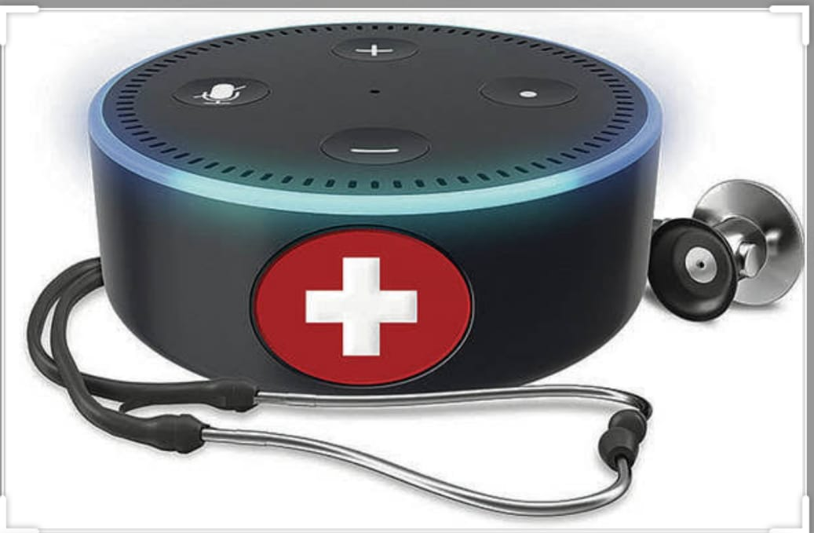
FIRST AID Assistance THROUGH ALEXA
AMAZON WEB SERVICES (AWS)

Slide 2
ABSTRACT
First aid is the first and immediate assistance given to any person suffering from either a minor or serious illness or injury.
In some cases, first aid consists of the initial support provided to someone in the middle of a medical emergency. The support might help them survive until professional help arrives.
In other cases, first aid consists of the care provided to someone with a minor injury. For example, first aid is often all that’s needed to treat minor burns, cuts, and insect stings.
We designed this project in such a way that it gives the immediate measures or steps to be taken for a particular emergency cases.

Slide 3
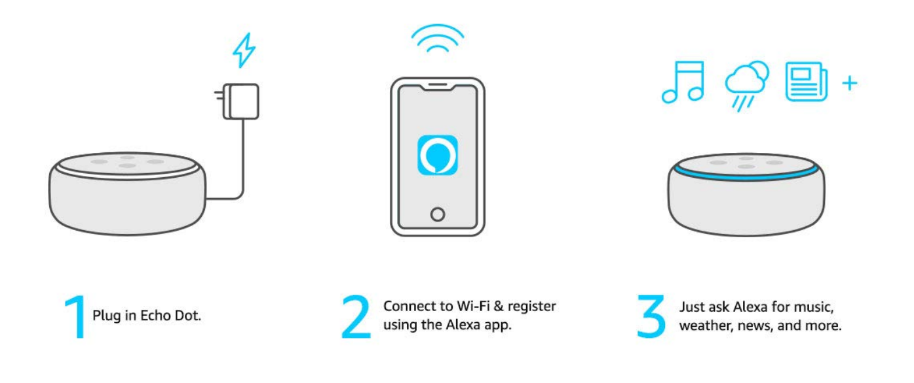
Simple to setup

Slide 4
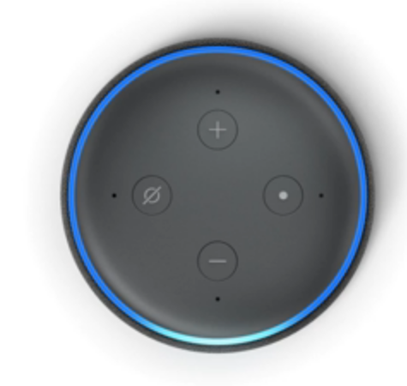



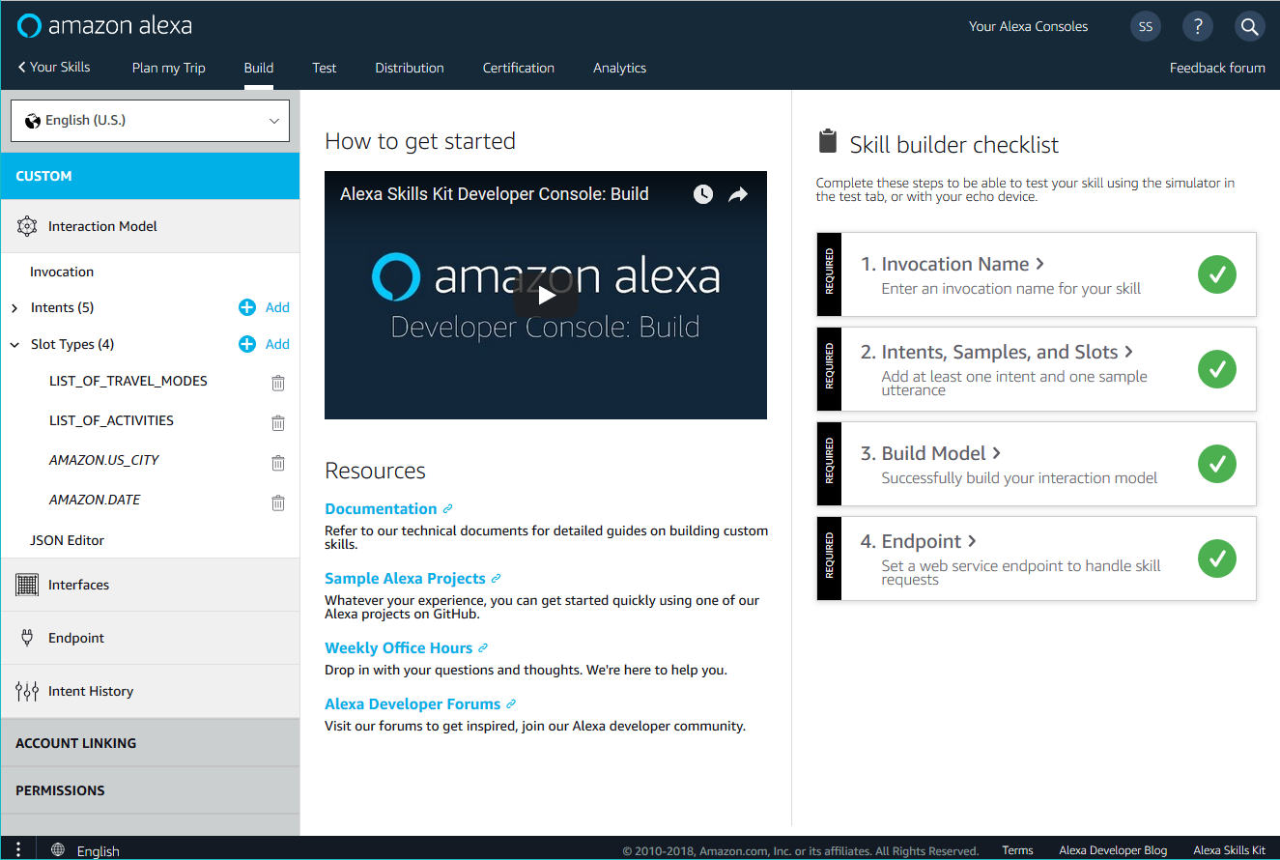
FLOW OF PROCESS
ALEXA DEVICE
LAMBDA AWS
MOBILE
ALEXA SKILL KIT
ALEXA DEVELOPER

Slide 5
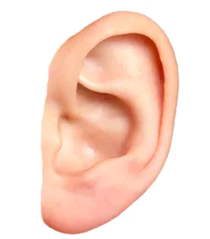
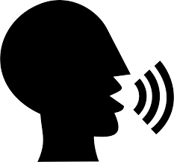

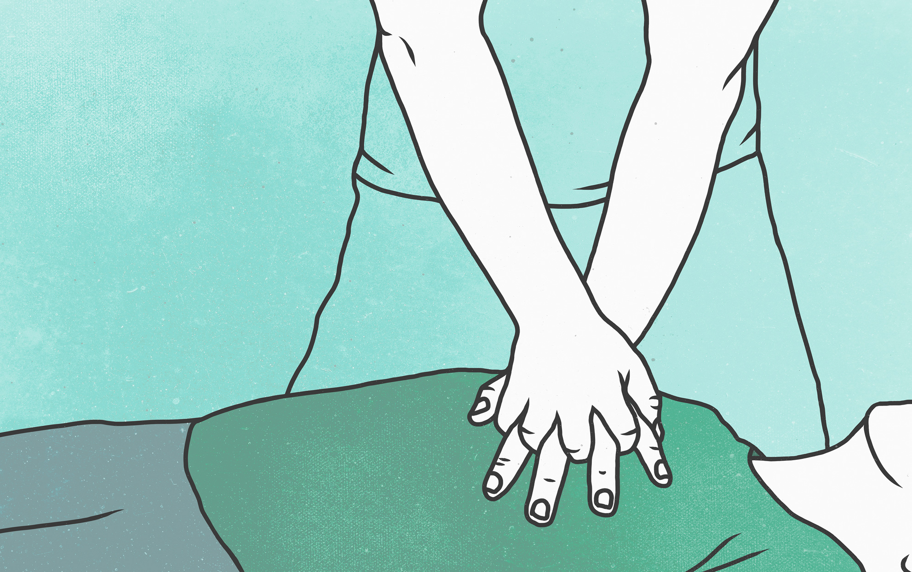
Ease of use
PROVIDING FIRST AID

Slide 6
advantages
It can save lives.
Reduce the number of workplace accidents.
Positive work environment.
Your company will be safer place to work.
First aid kits are used properly.
It can reduce recovery time.
It can keep employees safe outside of the workplace.
It's a great team-building exercise.

Slide 7

THANK YOU

